Slide 1
Power Curves:
Influence of Turbine Design Choices
Tomas Blodau
Dec 4th 2012

Slide 2

Aim
Wind conditions are highly variable on all sites
Good aerodynamic blade design can handle highly variable conditions
Power curve measurement show stable results for a wide variety of conditions

Slide 3
Agenda
Rotor Aerodynamics
PC Measurements
Summary

Slide 4
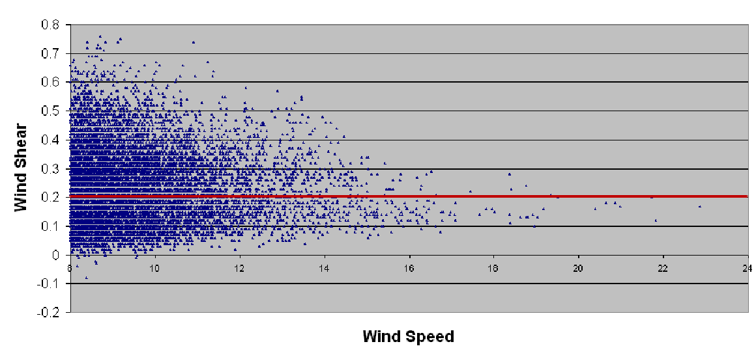
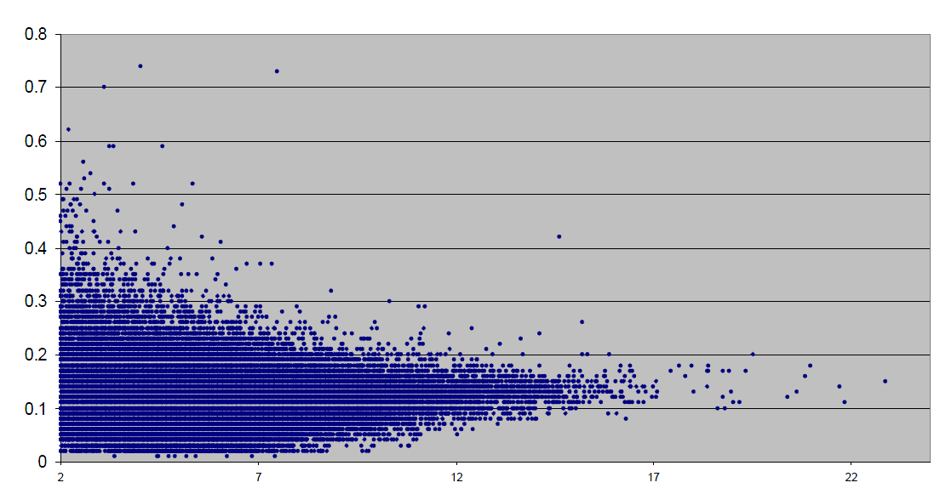
Rotor Aerodynamics
Variable Site Conditions
All sites show varying wind conditions
Turbine design needs to account for this.
Turbulence intensity
Wind Speed

Slide 5
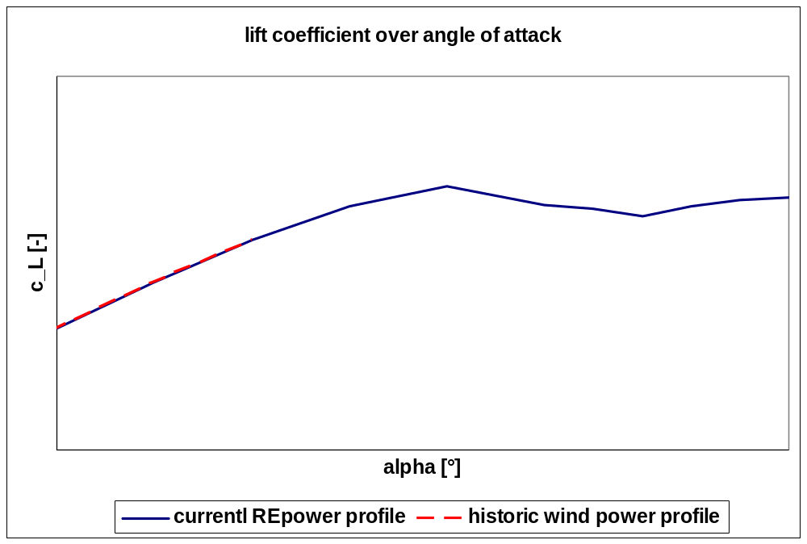
Rotor Aerodynamics
Influence of profile properties
u
u
α_{Des,hist}
α_{Des,RE}
α_{PostStall}
α_{PostStall}
α_{Stall}
α_{Stall}
v1
historic profile
v1
current REpower profile
v1
v1
Lift = ρ/2 A c_{L} v_{r}²
REpowers philosophy is to have a sufficient angle margin to stall.
smooth stall behaviour.
α_{Design,}
REpower
α_{Design}
historic
α_{Stall}
α_{PostStall}

Slide 6
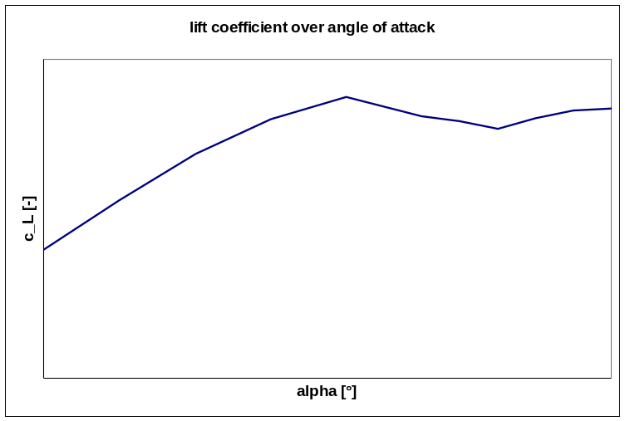
Rotor Aerodynamics
Airfoil characteristics
section A-A
u
α
V_{1,HH} = const
v_{1,upper blade}
section A-A
no shear
section B-B
u
α
v_{1, lower blade}
section B-B
α_{A-A}= α_{B-B}

Slide 7
Rotor Aerodynamics
Airfoil characteristics – shear influence
section A-A
u
α
V_{1,HH}=const
v_{1,upper blade}
section A-A
„normal“ shear (IEC)
section B-B
high shear
very high shear
shear exponent = 0.4
shear exponent = 0.2
shear exponent = 0.6
u
α
v_{1, lower blade}
section B-B
α_{B-B}
α_{A-A}

Slide 8
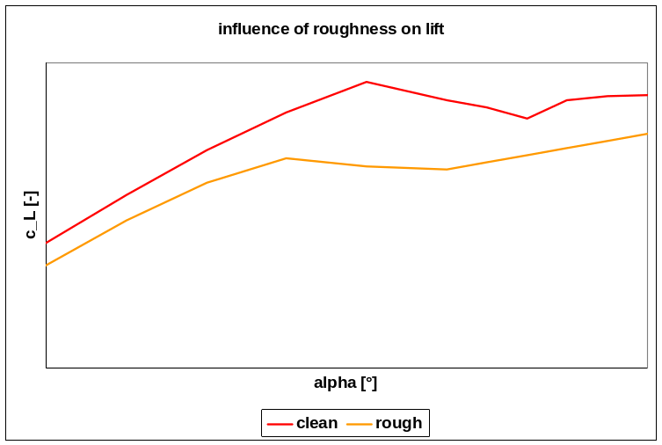
Rotor Aerodynamics
Airfoil characteristics – roughness influence
section A-A
u
α
V_{1,HH} = const
v_{1,upper blade}
section A-A
high shear
section B-B
u
α
v_{1, lower blade}
section B-B
α_{A-A}
α_{B-B}

Slide 9
Rotor Aerodynamics
Stall power and aerodynamic safety factor
u
chord
u
chord
α_{Des}
α_{Des}
short chord
(slender blade design)
REpower design
v1
v1
Lift = ρ/2 A c_{L} v_{r}²
A = f(…,chord)
Chord
Profile Thickness
Contamination Sensitivity
Stall Power
Loads

Slide 10
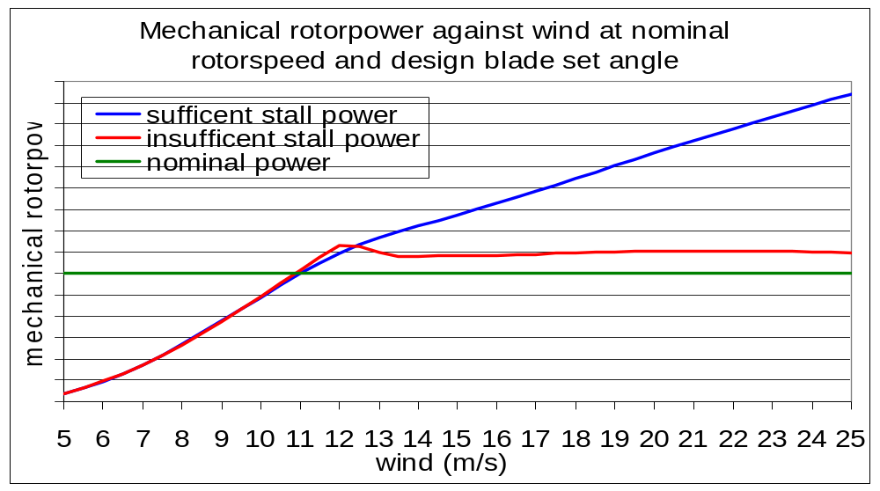
Rotor Aerodynamics
Stall power and aerodynamic safety factor
For high performance under varying conditions
REpower blades are designed with high Aerodynamic Safety Factors

Slide 11
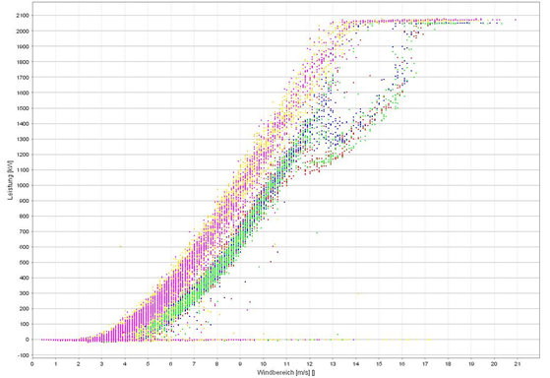
Rotor Aerodynamics
Aerodynamic safety factors
Wind turbine using REpower blade design (no stall effects seen)
Wind turbine showing stall effects

Slide 12
Agenda
Rotor Aerodynamics
PC Measurements
Summary

Slide 13
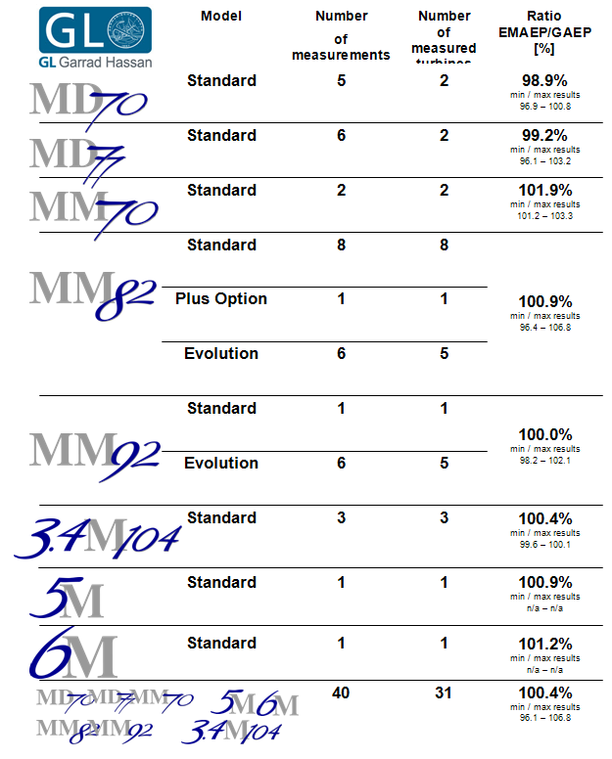
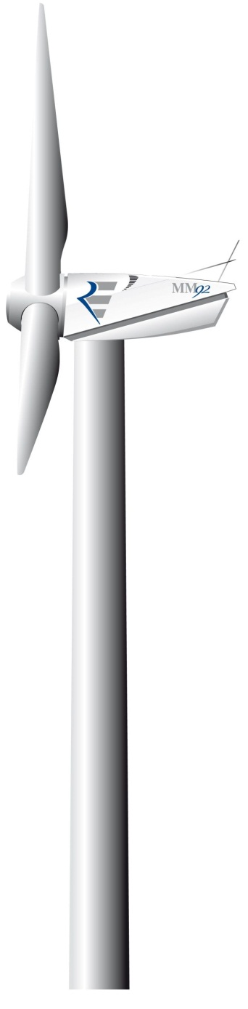
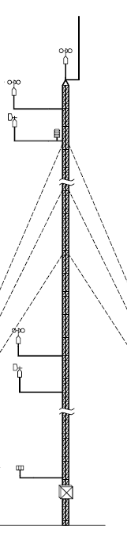
Power Curve Measurements
Power curve verification reference list

Slide 14
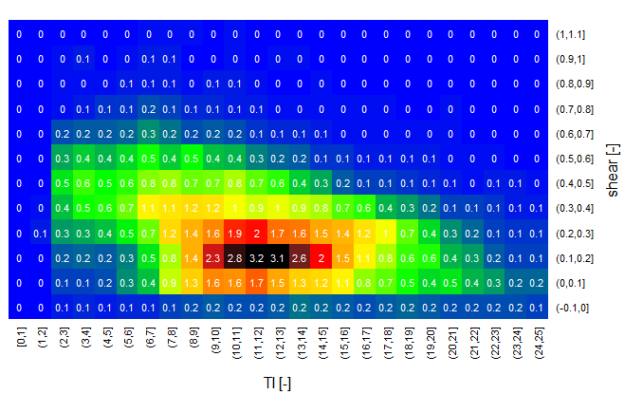
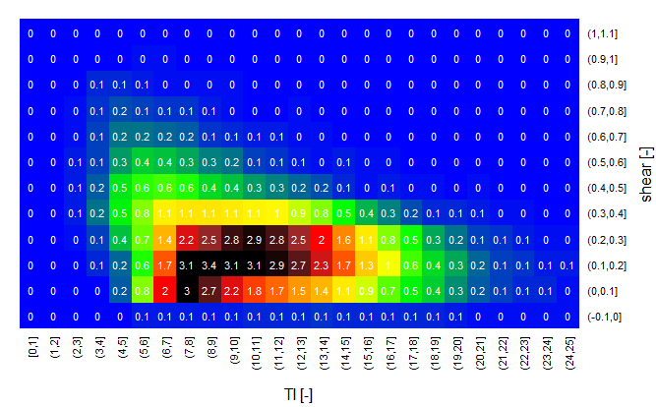
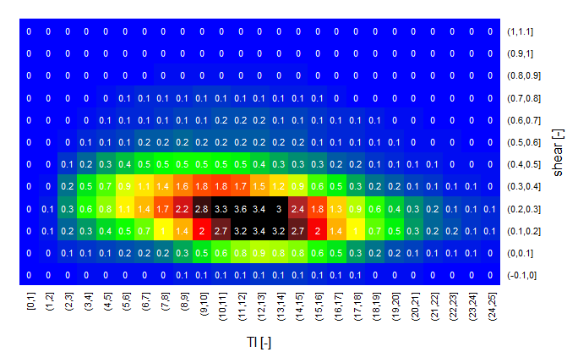
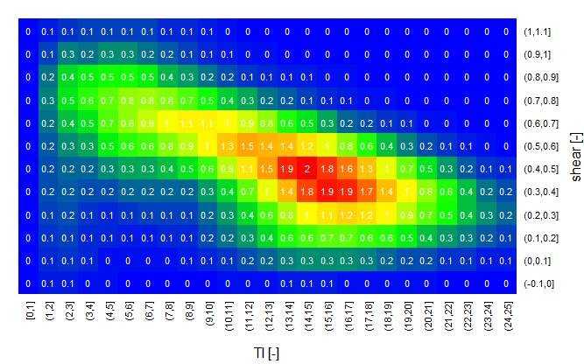
Power Curve Measurements
Varying site conditions

Slide 15
Agenda
Rotor Aerodynamics
PC Measurements
Summary

Slide 16
Summary
Wind conditions are highly variable on all sites
Good aerodynamic blade design can handle highly variable conditions
Power curve measurement show stable results for a wide variety of conditions

Slide 17

© REpower Systems SE
All rights reserved. No part of this document may be reproduced or transmitted in any form or by any means, electronic or mechanical, including photography, recording, or any information storage and retrieval system, without permission from REpower Systems SE.

